Slide 1




AeroTemp
3-5 Gantugs, Tuguldur, Tsengel, Bilguun

Slide 2
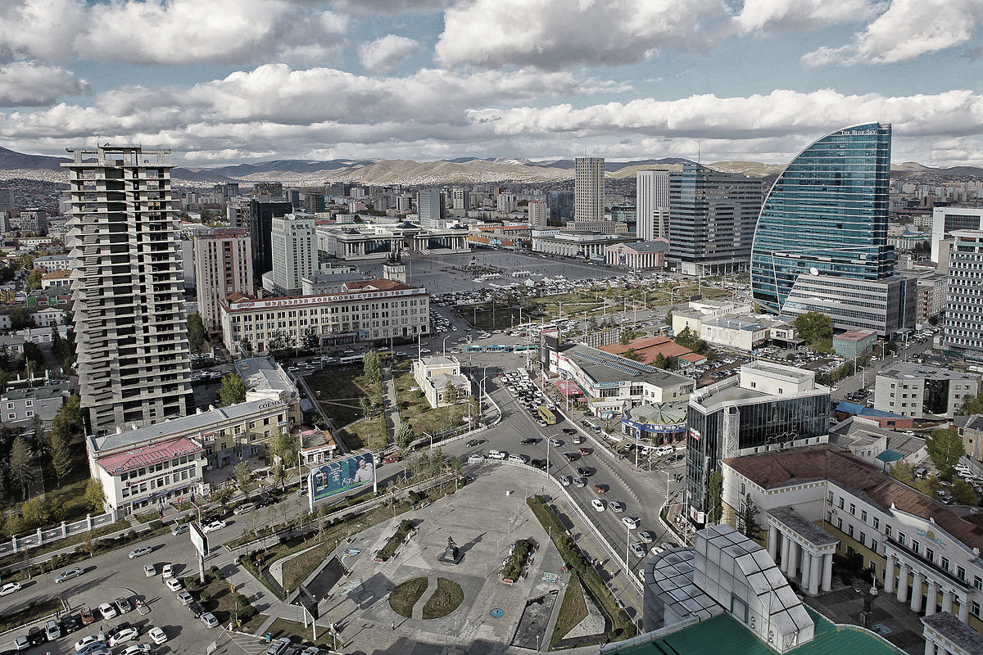



AeroTemp Home Network
z
Асуудлууд
Монгол
одоогийн
технологиоор
юу хийж чадах вэ?
C

Slide 3

Асуудлууд
Монголын технологи хөгжил нь дэлхийд:
60-д
https://gfmag.com/data/non-economic-data/most-advanced-countries-in-the-world/

Slide 4


Our solution
Энэ хэвээрээ үргэлжлэх зүгээр үү?
https://gfmag.com/data/non-economic-data/most-advanced-countries-in-the-world/

Slide 5







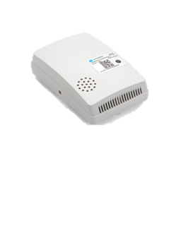



Бидний шийдэл
Mongolia’s technological advancement rank is:
60th
AeroTemp
Байр, байшинд зориулсан
IoT system ашигласан ухаалаг мэдрэгч
+
https://gfmag.com/data/non-economic-data/most-advanced-countries-in-the-world/

Slide 6






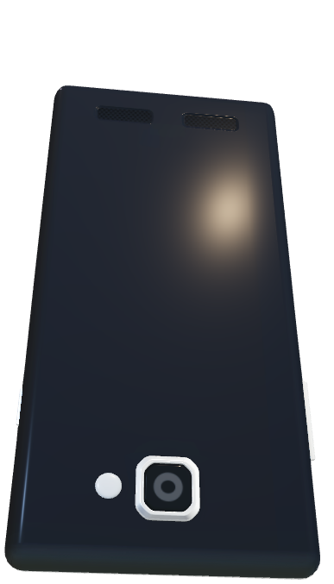
Our solution
Нэмж, сайжруулахад хялбар
Temperature
AeroTemp
Vertical development of smart apartments integrated with IoT systems
Data visualization for better buildings
Non-reliance on broadband network
Small & lightweight
Warehouse storage
Mass production
+
Угаарын хий хэмжих
Чийгшил

Slide 7
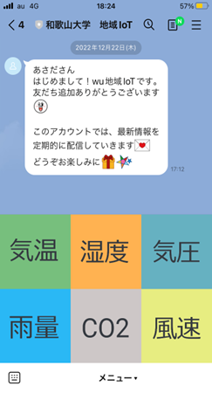
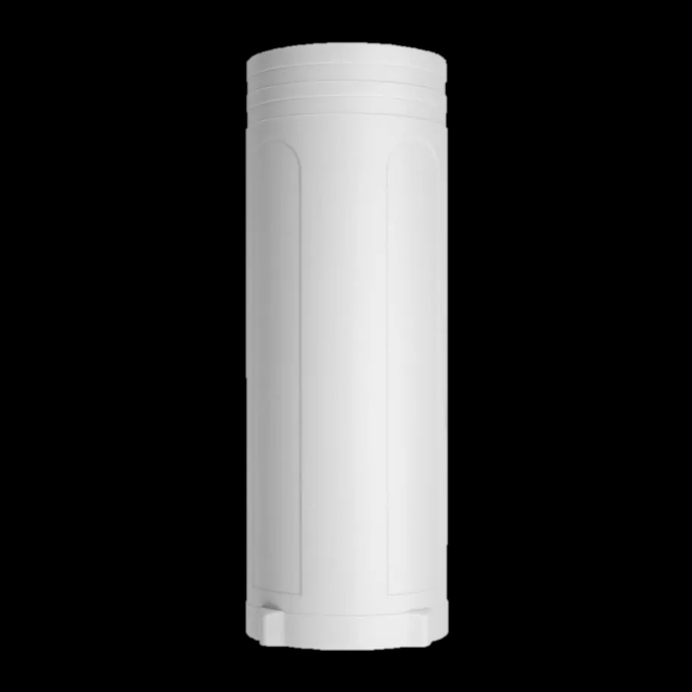
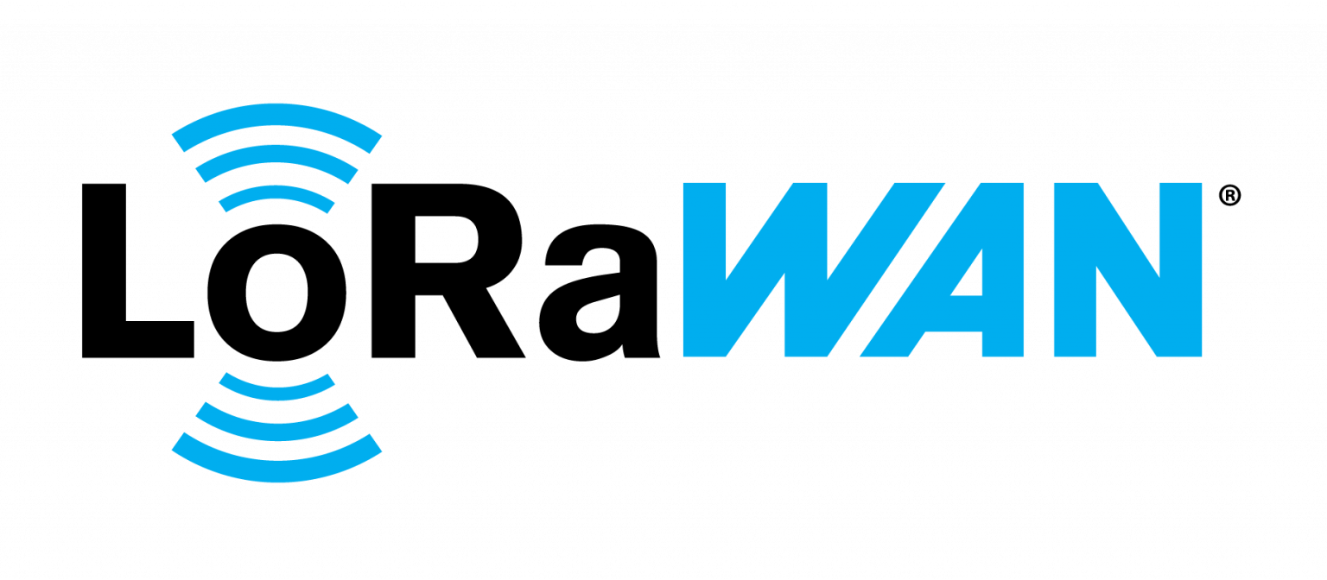

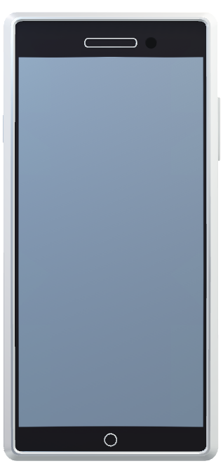
Туршилтын систем
Gateway
Analytics,
Хяналт

Slide 8



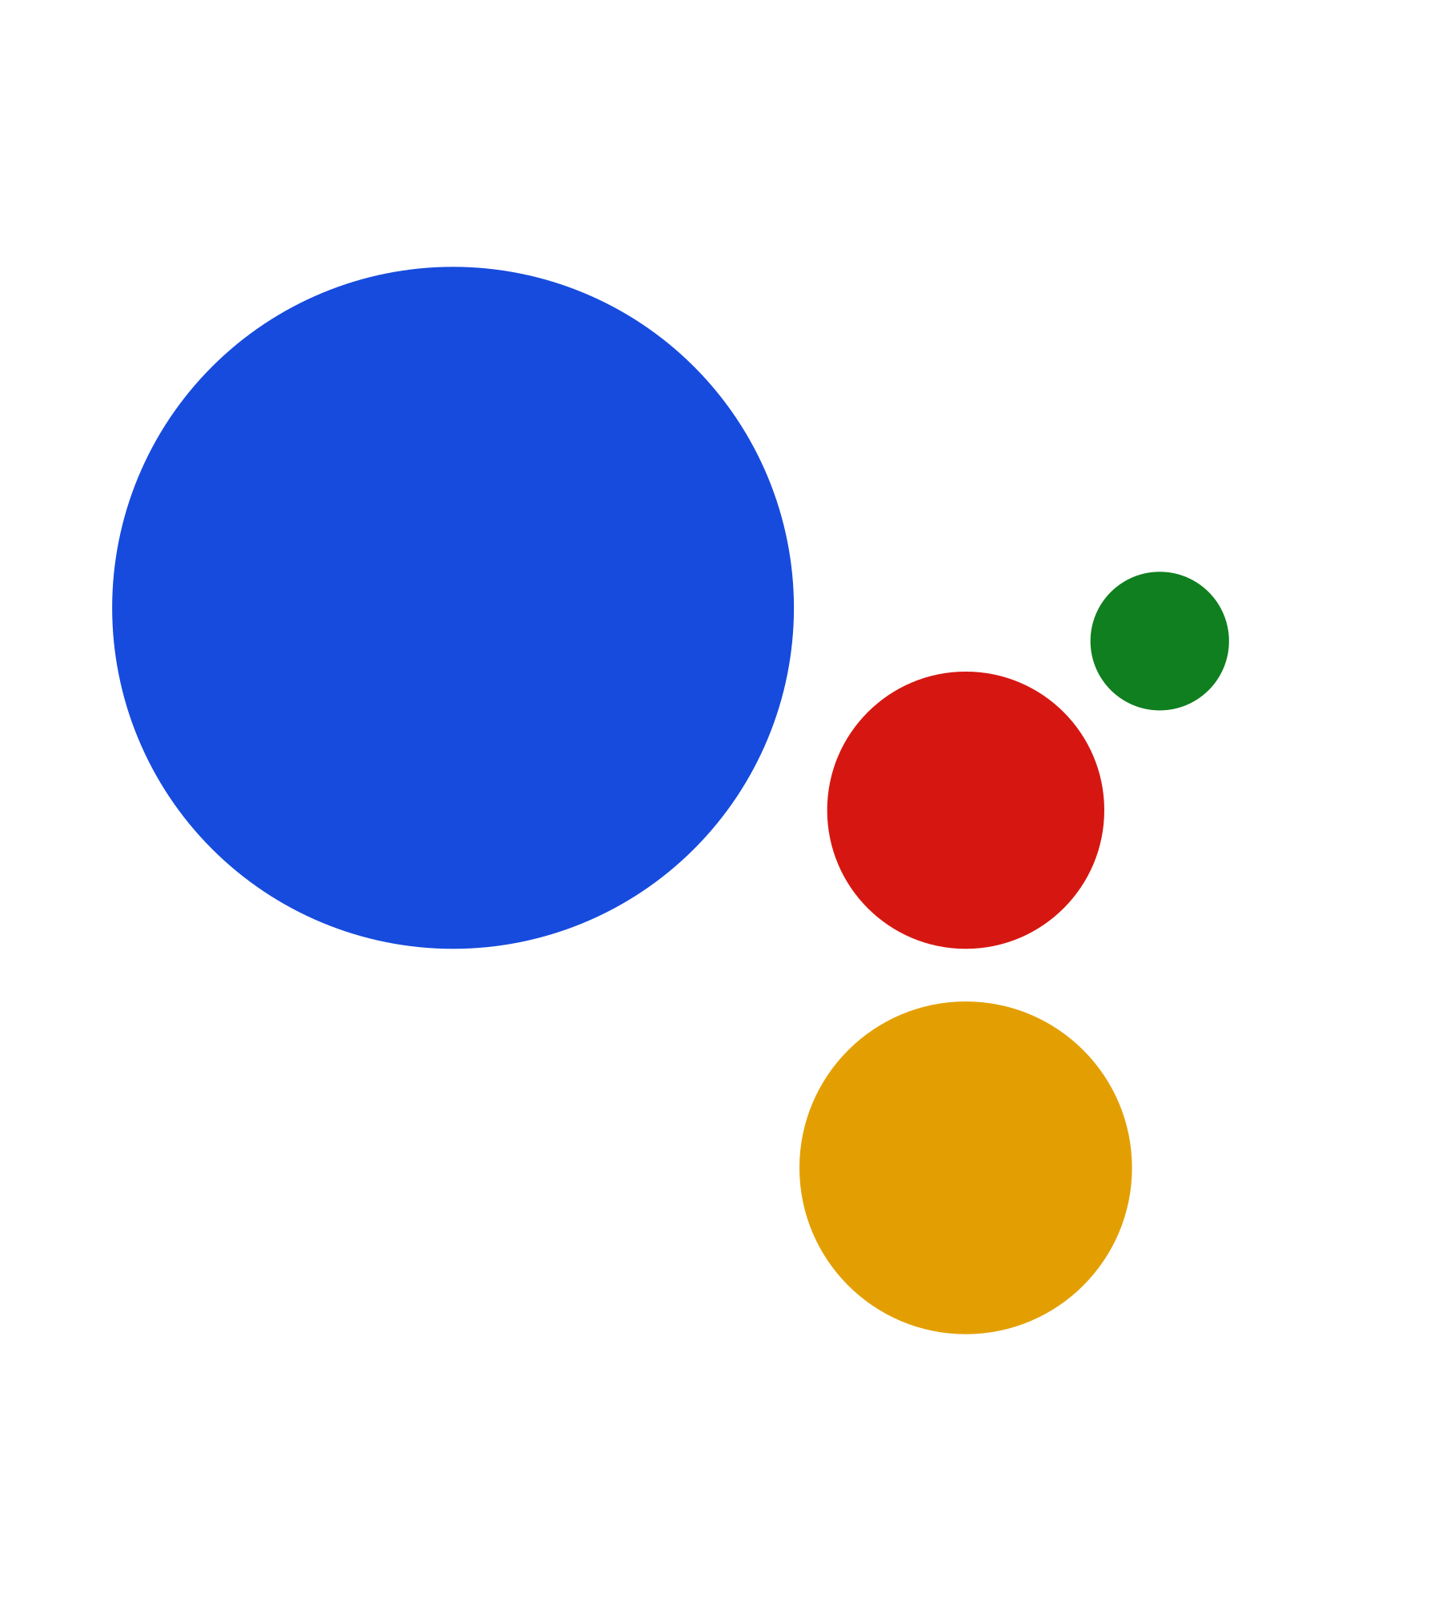

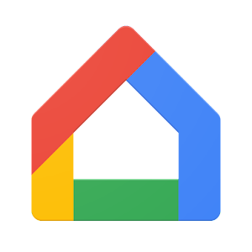




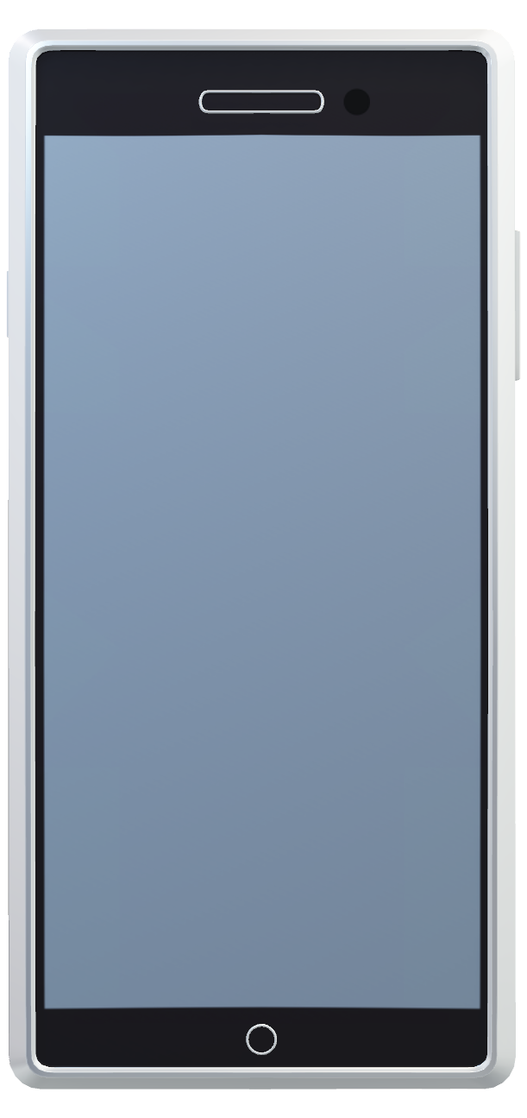
Төлөвлөгөөт систем
Gateway
Дохиолол, сануулга
Search…
Google Аssistant
Google Нome
Зохицуулалт
Data analyzation
Better building
Data base

Slide 9
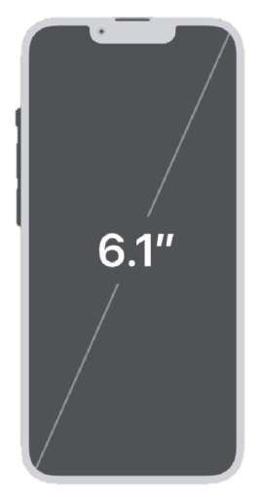
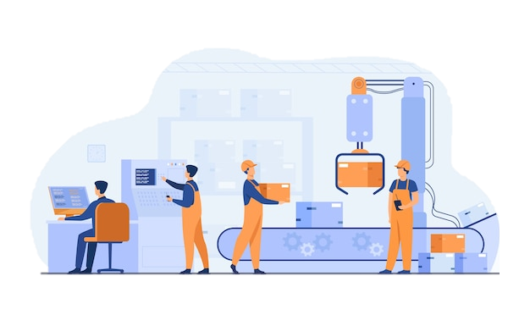
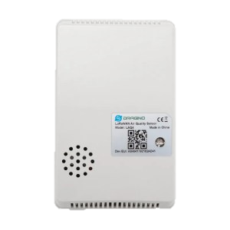

PROPOSED SYSTEM
Gateway
Information
Alerts
Search…
Google assistant
Google home
Regulation
FM (Facility Management)
Remote management of environment
Data collection for future projects
X
Барилга, байр сайжруулалт
(compared to phone)
Small & lightweight
Mass production
Non-reliance on broadband network
Data анализ
Database

Slide 10
X
Data analyzation
Better building
(compared to phone)
Data base
Жижиг, хөнгөн
Үйлдвэрлэлт хялбар
Утас, интернет сүлжээ шаардлагагүй

Slide 11

POINTS
Google Home SDK integration
Compatible with many smart devices on the market
Easy-to-use established partner-solution
Bulk data can be reused or sold to other industries.
Non-reliance on broadband network
Accessible price
Uninterrupted data flow at an affordable price
Reasonable price for both user and supplier(s)
Access from all over the world.
Mass production
Warehouse storage
Small & lightweight
Competitive pricing
Sustainable practices
accessible & affordable, suitable for mass production and supply to housing, construction projects

Slide 12
Бизнес төлөвлөгөө
Нийт хэргэлэгчидийн тоо 155`000
Олох боломжтой орлого
91 billion ₮
https://www.barilga.mn/n/11850/
Notes:
スマートシティ×サステナブル＝スマートシステムを用いた効率的なエネルギー使用→そのデータのためにIoT
BtoB、つまり企業側は安い値段でcentral air conditionを採用できるかつそのcentral air condition を採用していることをアピールできる。
→企業側にメリット
全館集中空調システム（central air condition)と個人空調を併用
→建物において、ボイラーなど熱源機器を一カ所に集中設置した空調システムのこと。建物全体の空調管理が可能。→単純な一括管理ではなく、IoTセンサーから得られるデータをもとに最適化、節約、サステナブル

Slide 13
SUSTAINABLE X SMART DEVELOPMENT
Бизнес төлөвлөгөө
30байр
1663сая
Үйлдвэрлэх үнэ (/ширхэг)
8,400JPY
200,000MNT
Production cost (/unit)
16,000JPY
390,000MNT
20байр
1091сая
Зарах үнэ (/ширхэг)
21,000～30,000JPY
500,000～700,000MNT
Selling price (/unit)
24,000～32,000JPY
590,000～790,000MNT
10байр
543сая
5байр
269сая
1байр
52сая
2байр
107сая
Сарын хураамж
84JPY
2,000MNT
Business hugaral
Acquired loan
BIM x IoT
(Planning, Construction)
FM (Facility Management)
Integration of IoT
in user’s daily life
Remote management of environment
Data collection for future projects
User’s ease of use
Smart devices & appliances integration

Slide 14
IoT-ийг амьдралд ойртуулцгаая
Thanks for your attention!
z

